Slide 1

SALES DATASET ANALYSIS Advanced Excel Project
J.K.KISHORE KANNAN
DADS/AN ONLINE BATCH

Slide 2
Objectives: To analyze sales data to uncover patterns ,identify trends and evaluate sales performances and provide information for business insights. Goals: 1. Provide clear insights into overall sales performances. 2. Identify top performing products , category and sales 3. Measure profitability and highest growth opportunities. 4. Access the impact of discounts on overall revenue. 5. Support business decision making through data-driven insights.
PROJECT DESCRIPTION & OBJECTIVE

Slide 3

DATA DESCRIPTION AND PREPARATION
Dataset contained transaction records across years from 2014 to 2017
contains columns with fields as orderid, date of order and shipped, ship mode and sales, quantity and discount
DATA CLEANNING:
Remove duplicates and outliers
Handled blanks and Data Validation
Sorting and filtering and adding columns for adjusted sales
Validate the discount and sales values are non negative

Slide 4
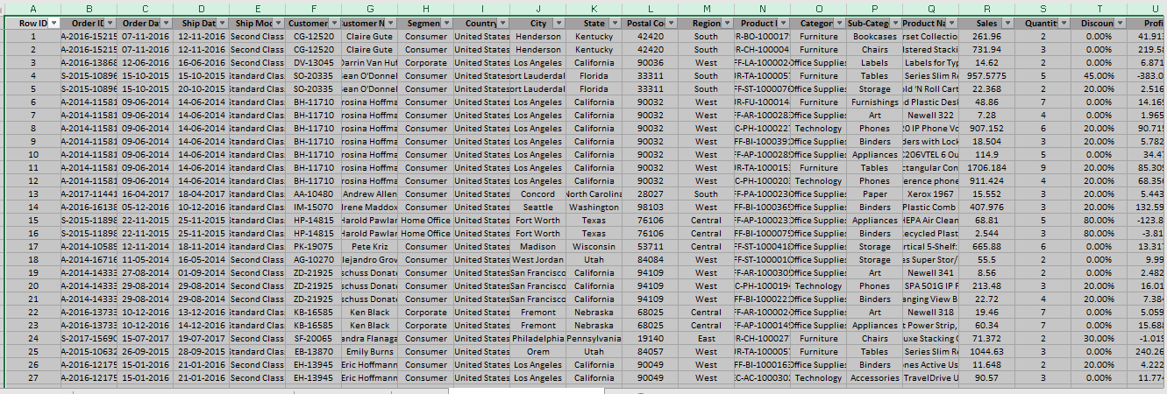
Quote
DATA CLEANING

Slide 5
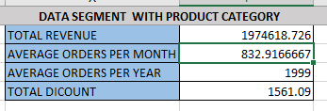
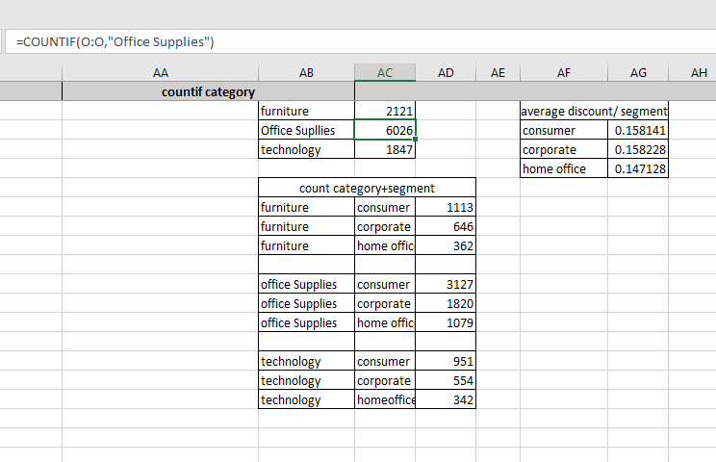
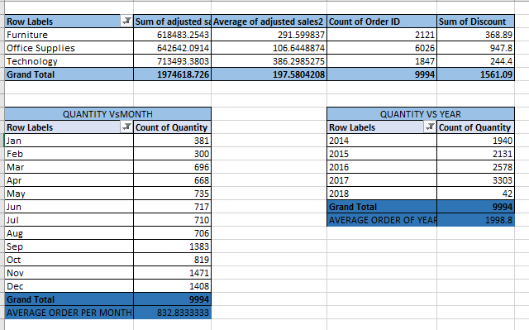
KEY MATRICES CALCULATION AND DATA ANALYSIS

Slide 6
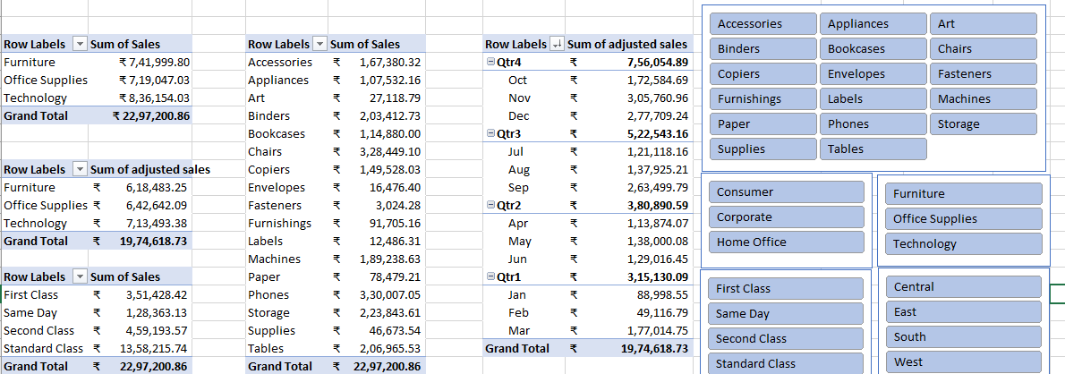
PIVOT TABLES AND SLICERS

Slide 7
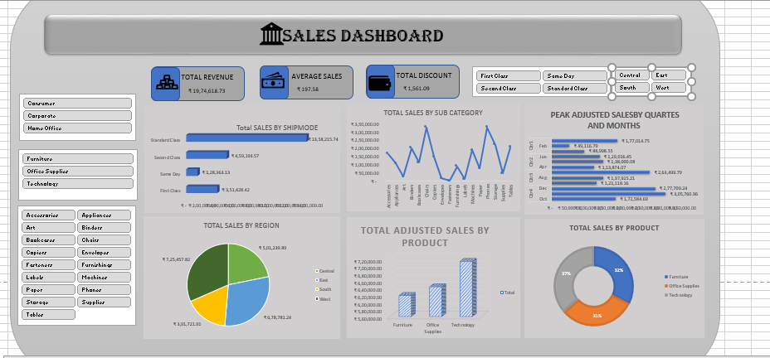

Slide 8
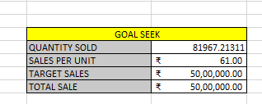
GOAL SEEK AND WHAT IF ANALYSIS
TARGET SALES Rs. 50,00,000 IN TOTAL REVENUE
INPUT QUANITY REQUIRED
SET CELL = TOTAL REVENUE
TO VALUE =
BY CHANGING CELL = QUANITY SOLD
GOAL SEEK

Slide 9
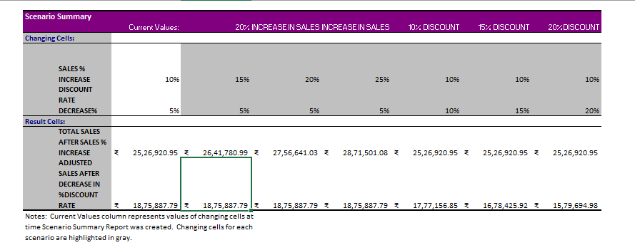
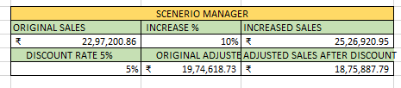
SCENARIO MANAGER
Various scenario created for the sales percentage increases and discount gets decreases where total sales increased after sales percentage gets increased , similarly adjusted sale decreased while decrease in discount percentage rate

Slide 10
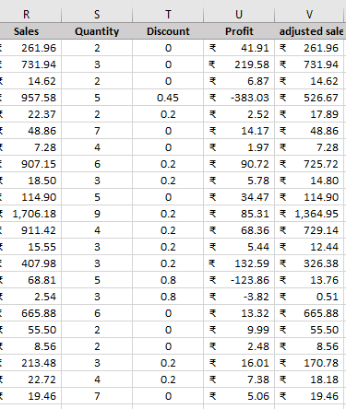
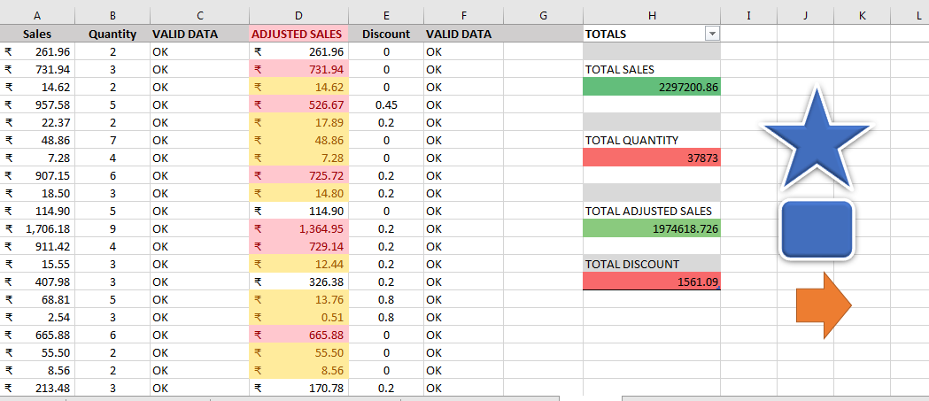
MACROS AND AUTOMATION
CREATED MACROS IN DIFFERENT SCERENIOS AND ADDED SYMBOLS FOR SPECIFIC FUNCTIONS AND SHORTCUTS
AFTER
BEFORE

Slide 11
INSIGHTS
RECOMMENDATIONS
Sales leads to find an adjusted sales value
Highest sales value in category in various region
Standard class shiping mode method was mostly used
West region had largest sales
Technology has highest discount rate
Phone, chairs, tables, are highest top 3 sales
Reduce discounts on products under higher sales
Improvement in bottom categories need to be sale
Add higher discount in lower categories sales in lowest region
Improve in shipping modes quite cost efficient

Slide 12

CONCLUSION
THIS ANALYSIS HELPS OUT TO ANALYZE SALES PERFORMANCE AND IMPORTANCE OF DISCOUNT AND CLEARANCE OF FURNITURES SALES UNDER TRENDS
DASHBOARD HELPS TO UNDERGONE KPI OF SALES EXPLORATATION

